Slide 1
Welcome
Early Years Unit
September 2020

Slide 2
The Early Years Team
Mrs Buckley Early Years Teacher
Mrs Robinson Early Years Practitioner
Miss Clarke Early Years Practitioner (mornings only)
Mr Price Principal
(Teaching Thursday mornings)

Slide 3
Start of the day
Classroom door will open at 8.30am.
Registration will be at 8.40 – 8.45am
If you arrive after this time and the door is shut you must go to the main reception for your child to be signed in.
If someone else is collecting your child at the end of the day please ensure you let us know.

Slide 4
Daily Routine
(Please be aware that this will change as we move through the year)
 | 8.30 – 8.45 | 8.50 – 9.00 |  | 9.00 – 9.50 | 9.50 – 10.00 | 10.00 – 11.30 |  |  | 11.30 – 12.00
Reception | Come in and settle to a simple ‘Start of the Day Activity’ at tables | Narrative session Based around a different story book each week |  | Learning Landscape Time (Inside and outside) Time to explore / free choice of activities (may be asked to complete a more focused task for a few minutes) | Phonics | Learning Landscape Inside & outside Time to explore / free choice of activities (may be asked to complete a more focused task for a few minutes) Rolling snack for all during this time |  |  | Put things back where they belong Wash hands Story
Nursery | Learning Landscape Free choice of activities in small / Nursery classroom |  |  |  |  |  |  |  | Nursery Story & ready for home or Lunch
12.00 – 12.45 | 12.45 – 1.00 | 1.00 – 1.10 | 1.10 – 2.20 |  |  |  | 2.20 – 2.50 | 2.50 – 3.15
LUNCH | Wash hands, registration | Reception Maths / Counting Fun | Learning Landscape Time (inside and outside) Time to explore / free choice of activities (may be asked to complete a more focused task for a few minutes) |  |  |  | Afternoon activity (PE / ICT / Discovery / PSHE) | Wash hands Things ready for home Story Time
 |  | Nursery Story / Quiet time

Slide 5
What do they need?
PLEASE ENSURE ALL ITEMS ARE CLEARLY NAMED
Change of clothes to stay at school – all sorts of accidents can happen!
Warm layers – Jumper / cardigan
Warm waterproof coat as we will be outside in all weathers
Wellies to keep in school please
PE Kit (to be worn to school on Tuesdays)
white T-shirt, black shorts or trousers and trainers/plimpsolls
Warm hat, scarf & gloves for cold autumn / winter days
Sun cream (when needed - please apply before coming to school as well as providing some for them to top up in the afternoon)
Sun hat during summer months
Book bag or good sized rucksack to carry letters and reading books, flash cards etc. These will be needed later in the year, but not necessary at the moment. So, to help your child organise their own belongings at this time it would help to only send lunch bag, water bottle and any daily supplies of pull-ups / nappies.

Slide 6
This is how we build up a record or your child’s learning throughout the year by uploading comments, photos and videos etc
We need your permission to be able to do this, so please ensure you return the form.
We will endeavour to upload at least two observations of your child per week
You can access this to see snapshots of what your child is doing at school
It would be great if you could add your own comments and observations too (photos, videos or just a short note), so we can see what your child is doing at home

Slide 7
EYFS - Early Years Foundation Stage
3 Characteristics of Effective Learning
7 Areas of learning
17 Early Learning Goals

Slide 8
The term ahead
Our ‘Big Question’ for this term is ‘What’s the Story?’
Over the coming weeks we will discuss:
Me and my family
All the things I love doing
How I grow
What’s inside my body
Where we live
Our new friends

Slide 9
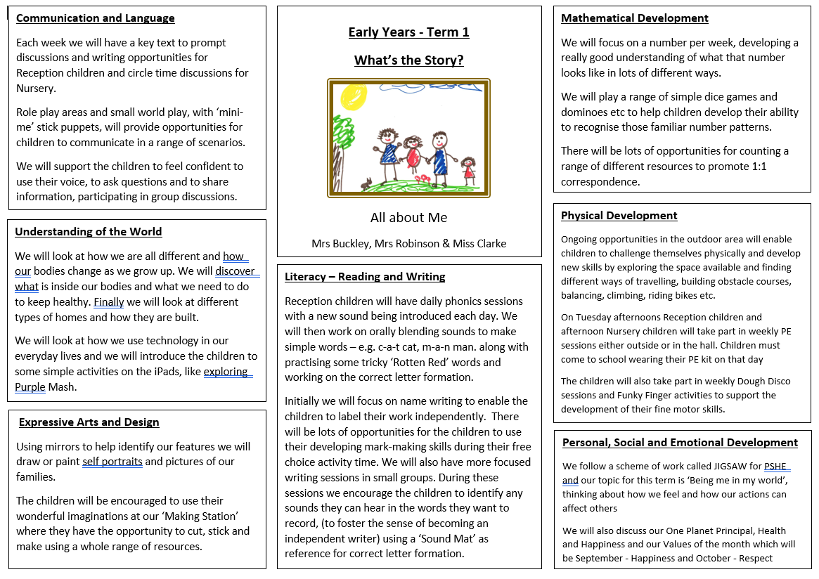
The term ahead

Slide 10
Phonics and reading
This is the scheme we use to teach phonics on a daily basis
Each day we will learn a new letter sound with fun and interactive sessions
We will send home sets of ‘Rotten Red’ words. These are words that cannot be decoded phonetically and just need to be learnt by sight.
Later in the year reading books, linked to the RWI scheme will be sent home, we’ll tell you more about this later
Remember we want children to learn to love reading so don’t push too hard (little & often is the key) and it’s important to share the joy of books by reading to / with your child every day, at bedtime or anytime of the day.

Slide 11
Reading in Reception
Although we will not be sending any reading books home for the first term we still want to help support and encourage a love of reading, so in the meantime we will be sending home a ‘Share at home’ book for you to enjoy with your child. These will be good quality picture books, which the children will bring home on Fridays, for you to read and enjoy with them over the weekend, then please return them to school on the Monday so they can be ‘quarantined’ for 3 or 4 days before they go home with another child the following Friday.

Slide 12
Behaviour
We will discuss and agree ‘class rules’ with the children during the first few weeks
We will remind the children that at Gagle Brook we care about:
Our learning
Each other and
The world around us
Remember ‘STEP’:
Say
Thank you
Excuse me and
Please
The children will be awarded ‘Dojo points’ as a way of recognising effort, making good choices & being kind.

Slide 13
Communication
The happiness and welfare of your child are of great importance to us all and whereas we might normally have a quick chat at the end of a school day, the current situation prevents us from doing that, however good communication is still vital.
Ways to contact us:
If it’s a general enquiry specific to Early Years please use the EY Class Group on Tapestry
If you would like to speak to me directly please email admin@gaglebrook.org.uk and either Mrs Hopkin can pass on a message or just let her know if you would like me to give you a call at the end of the day to have a chat. (Please, don’t let a ‘little niggle’ bubble away until it’s a major concern, please let us know straight away to so we can either put your mind at rest or take an action as soon as possible.)

